Slide 1
Control structure ( Conditional statement/ if-statements)

Slide 2
What is control structure or conditional statements ?
Control structure is also known as decision making statement.
As the name implies, decision allows us to run a particular block of code for a particular decision.
Condition checking is the backbone of decision making.
Control structure allow us to say what happens if condition is either true or false.
It is also known as If- statements.

Slide 3
Indentation :
For the ease of programming and to achieve simplicity, python doesn't allow the use of parentheses for the block level code. In Python, indentation is used to declare a block. If two statements are at the same indentation level, then they are the part of the same block
Generally, four spaces are given to indent the statements which are a typical amount of indentation in python.
Indentation is the most used part of the python language since it declares the block of code. All the statements of one block are intended at the same level indentation.
Python relies on indentation, using whitespace, to define scope in the code. Other programming languages often use curly-brackets for this purpose.

Slide 4
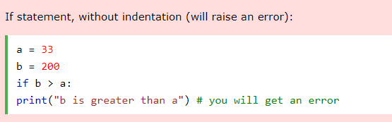
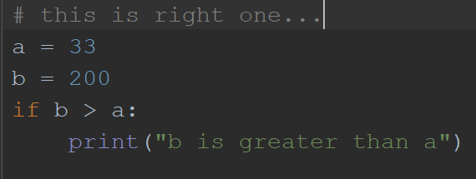
Example :

Slide 5
Control Flow :
The order of execution of the statements is know as control flow.
Till now we have used sequential flow of execution (sequential control flow)
If we use conditional logic statements( if -statements), it is conditional flow of execution. It means the control flow of the program depends upon the condition .

Slide 6
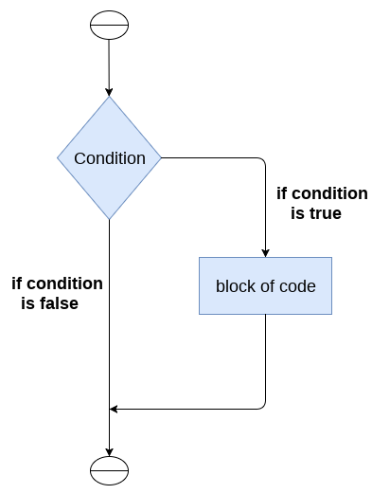
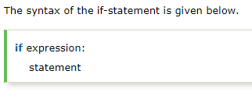
If - statements :
The if statement is used to test a particular condition and if the condition is true, it executes a block of code known as if-block

Slide 7
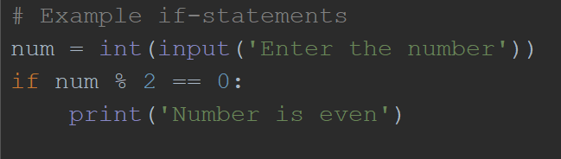
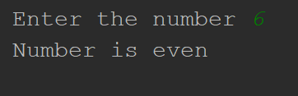
Example :
Output

Slide 8
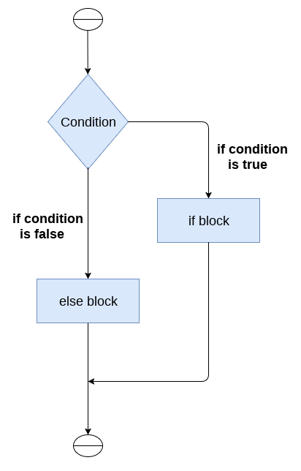
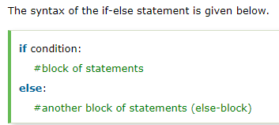
if – else statements:
The if-else statement provides an else block combined with the if statement which is executed in the false case of the condition.
If the condition is true, then the if-block is executed. Otherwise, the else-block is executed.

Slide 9
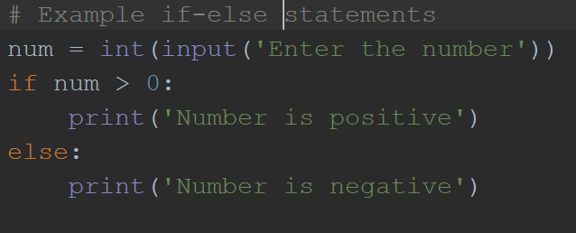

Example :
Output

Slide 10
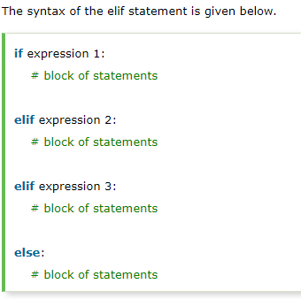
elif – Statements :
The elif statement enables us to check multiple conditions and execute the specific block of statements depending upon the true condition among them.
We can have any number of elif statements in our program depending upon our need. However, using elif is optional.

Slide 11
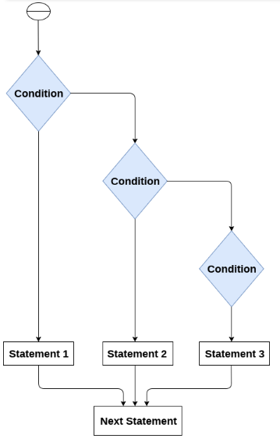
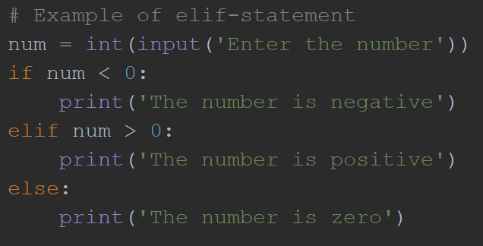
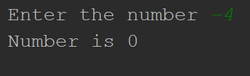
output

Slide 12
Flowchart :
A flowchart is a diagram that depicts a process, system or computer algorithm.
They are widely used in multiple fields to document, study, plan, improve and communicate often complex processes in clear, easy-to-understand diagrams.
Flowcharts, sometimes spelled as flow charts, use rectangles, ovals, diamonds and potentially numerous other shapes to define the type of step, along with connecting arrows to define flow and sequence.

Slide 13
Common Symbol used in flowchart :
Rectangles for process
Diamonds for decisions
Arrows for flow
Circles for input and output

Slide 14
For any complex program it is a good idea to first make a flowchart.
Why:
Focus on algorithm rather than syntax;
Visual representations easier to work with

Slide 15
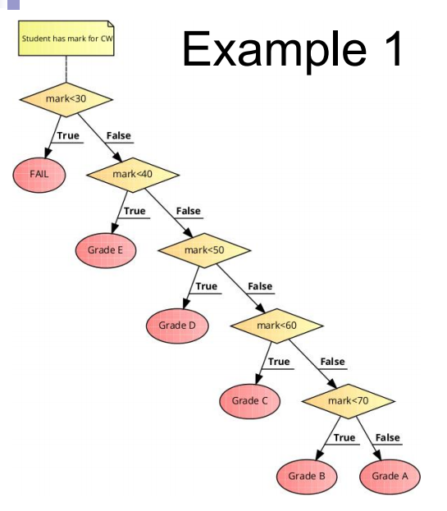

Slide 16
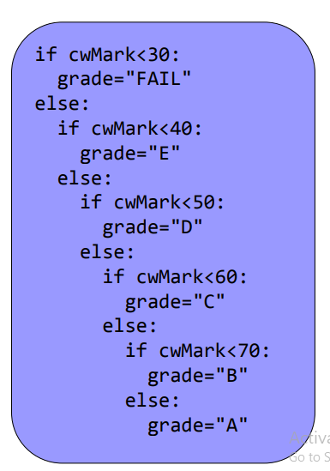
Implementation

Slide 17
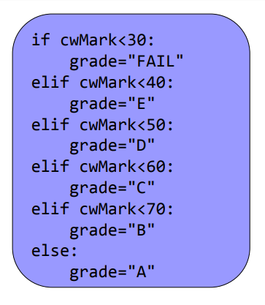
There are multiple ways of doing it.

Slide 18
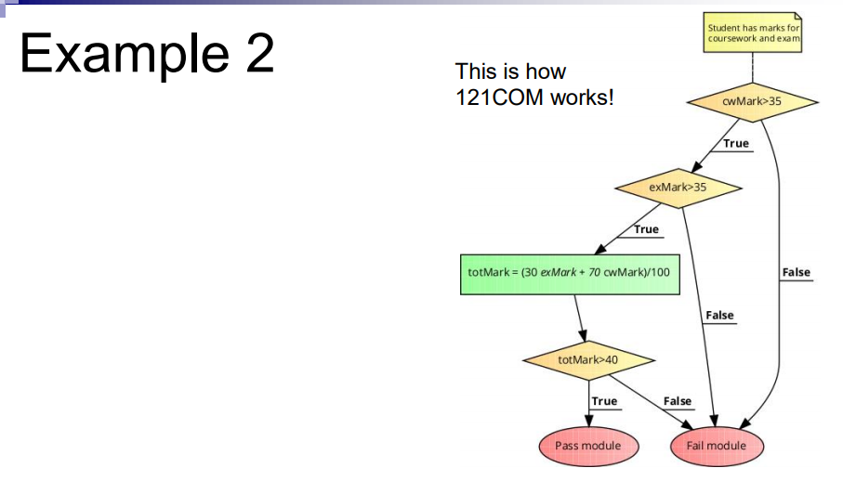

Slide 19
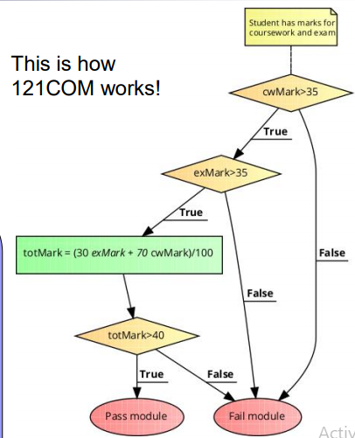
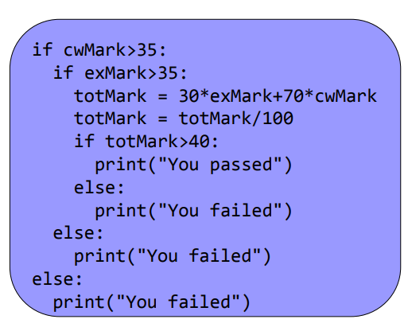
Implementation

Slide 20
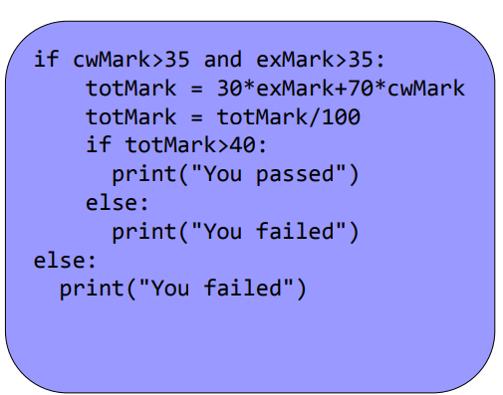
Logical operators can be used to avoid nested-if statements
Implementation

Slide 21
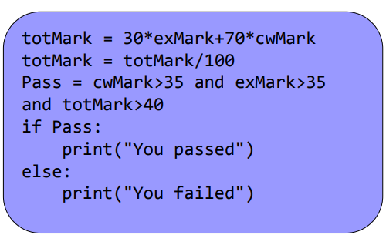
More we are using logical operator to avoid nested-if
implementation

Slide 22
Workout :
Time to draw your own flowcharts and write your own logic.
Q) Draw the flow chart first then write your logic of following problems.
Basic salary of an employee is entered by user. He has 5% daily allowance of his basic salary and allocate 10 % of his basic salary for expenses. Display how much salary he has remaining.

